Slide 1
Akebono Comes to Williamsburg
Notes:
Courtesy of Hector Guerrero .

Slide 2
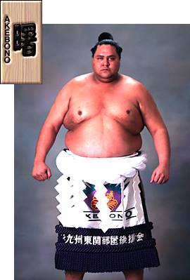
Weight: 514 lbs Height: 6 f 8 in Record: 654-232-181 Aggressiveness: Thrust: Hunger:
Chad Rowan (aka Akebono)
https://www.youtube.com/watch?v=xLFYuyJTxGI

Slide 3

Not Street Fighter’s E. Honda

Slide 4
Business Opportunity Open a restaurant in Williamsburg that serves the freshest sashimi. Akebono’s favorite are Bluefin and Yellowfin Tuna must be offered. He gets angry when he doesn’t get his 7000 calories.

Slide 5
The Simulation Model
As the restaurant owner, you would like to know how many pounds of fish will be available daily from OBX. If you promise Akebono an average quantity of daily pounds, what should it be? Present the data from your simulation in clever and interesting ways given given our desire to not make Akebono mad.

Slide 6
The Report
North Carolina’s Outer Banks is the location for fishing. Boats set out early (3:30 am) in the morning. The captains of the boats observe the fishing conditions. You survey the captains and there seems to be consensus that the catch is dependent on the fishing conditions. The conditions occur as follows: Great:10% , OK:60%, Bad:30%
Given the fishing conditions, the arrival process (# fish in daily catch) is Poisson distributed with the averages of the distributions occurring as: Great:7, OK:4, Bad:2 (lambda = fish/day)
The mix of Yellowfin and Bluefin are observed to follow the following regime: 25% of occasions 0% are Yellowfin; 50% of occasions 25% are Yellowfin; 25% of occasions 35% are Yellowfin.
The weight of fish is important. Only fish weighing in excess of 20 lbs. are allowed for capture. Yellowfin and Bluefin average 30 and 35 lbs., respectively. The weight is normally distributed with a standard deviation of 18 lbs. for both fish. The NC Game and Wildlife Dept. are very ready to prosecute the weight limits vigorously (loss of fishing rights and a large penalty).

Slide 7
The Report
Finally, once the catch is determined, a % (proportion) of the fish represents the edible yield— this is determined from a Beta Distribution with an alpha=70 and beta=30. This percentage is for the base case of OK fishing conditions. If the conditions are Great the base case is increased by 10%, and if conditions are Bad the base is decreased by 25%. Yield represents the edible pounds of fish.
Tuna is caught daily and brought to a dock at 11:30 am where you have an agent there to buy and immediately transport the tuna to Williamsburg via helicopter.

Slide 8
Questions
How many fish are caught of each type on average (daily)? Create a histogram of the daily catch. What is the probability that no fish are caught in a day?
How many pounds of edible fish are caught on average (daily) per type of fish? Create a histogram of the daily pounds of edible fish for each type.
What is the probability that the total edible fish available of both types is less that 20 lbs. on a given day? What is the mean value of lbs. that you can offer per day?

